Slide 1

Introduction to Biostatistics & R
SUIP Biostatistics Workshop
Wednesday, June 7, 2023
Session 2

Slide 2
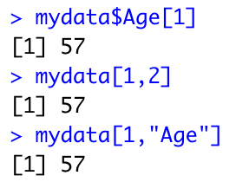
Warm Up Exercise
1. Create a numerical vector of odd numbers: 1, 3, 5
2. Create a character vector of primary colors: red, blue, yellow
3. Use the read.csv() function to load in the mydata.csv file and save it as a dataframe “mydata”
For iOS
mydata <- read.csv("/Users/mkca/Downloads/mydata.csv", header = TRUE)
For Windows
mydata <- read.csv("C:\\Users\\mkca\\Downloads\\mydata.csv”, header = TRUE)
2. Use the $ method to print out the SystolicBloodPressure variable in mydata
3. Print out the 3rd element of the BMI variable, using any syntax of your choice.
4. Print out the 12th row, what can you tell me about this individual?
Will the 12th row always correspond to the 12th individual?
5. Use class() to see what types of variables Gender, BMI, and Age are
What is another way without using a function?
6. Use the subset() to select individuals who are hypertensive
7. What is the difference between Data and Values within the R environment?

Slide 3
Questions from last time (1)
Many arguments for functions in R have “default values” and if you don’t tell R what to use, it uses default
Example:
The round() function has two arguments: x (the number we want to round) and digits (number of digits to round to)
> round(
x = 3.1415,
digits = 2 )
[1] 3.14

Slide 4
Questions from last time (1)
Many arguments for functions in R have “default values” and if you don’t tell R what to use, it uses default
Example:
The round() function has two arguments: x (the number we want to round) and digits (number of digits to round to)
> round(
x = 3.1415,
digits = 2 )
[1] 3.14
> round( x = 3.1415 ) [1] 3
The default number of digits to round to is digits =0 which is what R uses if you don’t specify

Slide 5
Questions from last time (1)
Many arguments for functions in R have “default values” and if you don’t tell R what to use, it uses default
Example:
The round() function has two arguments: x (the number we want to round) and digits (number of digits to round to)
> round(
x = 3.1415,
digits = 2 )
[1] 3.14
> round( x = 3.1415 ) [1] 3
The default number of digits to round to is digits =0 which is what R uses if you don’t specify
Question from last time: Can we change these defaults if we want to?
Answer: No, but we can write our own function with our own defaults!

Slide 6
Writing your own function
> myround <- function(x,digits){
answer <-round(x,digits=2)
return(answer)
}
> myround(3.1415)
The round() function has two arguments: x (the number we want to round) and digits (number of digits to round to)
[1] 3.14

Slide 7
Try it yourself:
Exercise 1.2.5: Writing your own function
Write your own function in R called ”myround” which rounds to 3 digits by default instead of the 0 used by default by round
Hint:
(my new function above rounds to 2 digits!)
myround<-function(x,digits){
answer<-round(x,digits=2)
return(answer)
}

Slide 8
Questions from last time (2)
Is <- the same as = in R?
Example:
<- is an assignment operator
= is either an assignment operator or a distinct syntactic token (its use changes depending on context it is used in)
For the purpose of assigning variables, these are equivalent, but <- only works as an assignment operator, while = is used for many other purposes
Example: round(x = 3.1415)
> age <- 27
> age = 27

Slide 9
Outline for Today’s Workshop
Present some key terms in statistics
Discuss types of variables we might find in real data
Introduce descriptive statistics
Show how to present descriptive statistics in R
Calculate measures of central tendency and spread
Tabulate categorical variables
Summarize variables graphically
Calculate correlations to understand the relationship between two variables
If time: cover a few important practical matters in R

Slide 10
Key Terms (1)
Population: a complete group with a particular characteristic (all subjects of interest)
Sample: a subset of the population for which data are collected for a study
Data: the information collected to answer the research question
Variables: characteristics of the study population, exposures (e.g. treatment), and health outcomes of interest
Anything that varies with the set of data
Subjects: units/people whose characteristics, exposures, and outcomes we’re interested in

Slide 11
Key Terms (2)
Parameter: The value of a variable in a population
Statistic: The value of a variable in a sample
Statistical Inference: the procedure through which we make inferences about an underlying population based on certain characteristics from a sample of data drawn from that population

Slide 12


Sample from Population
Not realistic/possible to analyze the entire population, so we analyze a sample
Summary measures computed on the sample are used to make statistical inference on the corresponding population parameters
Population
(parameters)
$$μ$$
Sample
(statistics)
$$\overline{x}$$

Slide 13

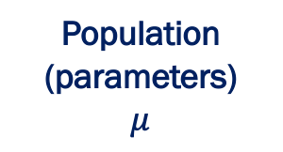

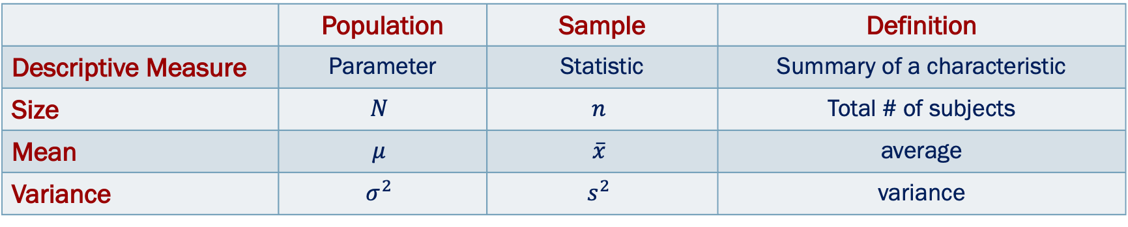
Sample from Population
Population quantities (parameters): Greek letters
Mean = $μ$, variance = $σ^{2}$
Sample quantities (statistics): Roman letters
Mean = $\overline{x}$, variance = $s^{2}$
Population
(parameters)
$$μ$$
Sample
(statistics)
$$\overline{x}$$
 | Population | Sample | Definition
Descriptive Measure | Parameter | Statistic | Summary of a characteristic
Size | $$N$$ | $$n$$ | Total # of subjects
Mean | $$μ$$ | $$\overline{x}$$ | average
Variance | $$σ^{2}$$ | $$s^{2}$$ | variance

Slide 14
Steps to Making Statistical Inference
Collect a sample
Analyze the data: calculate summary statistics
Make inference about unknown population parameters (e.g. population average from sample mean)

Slide 15
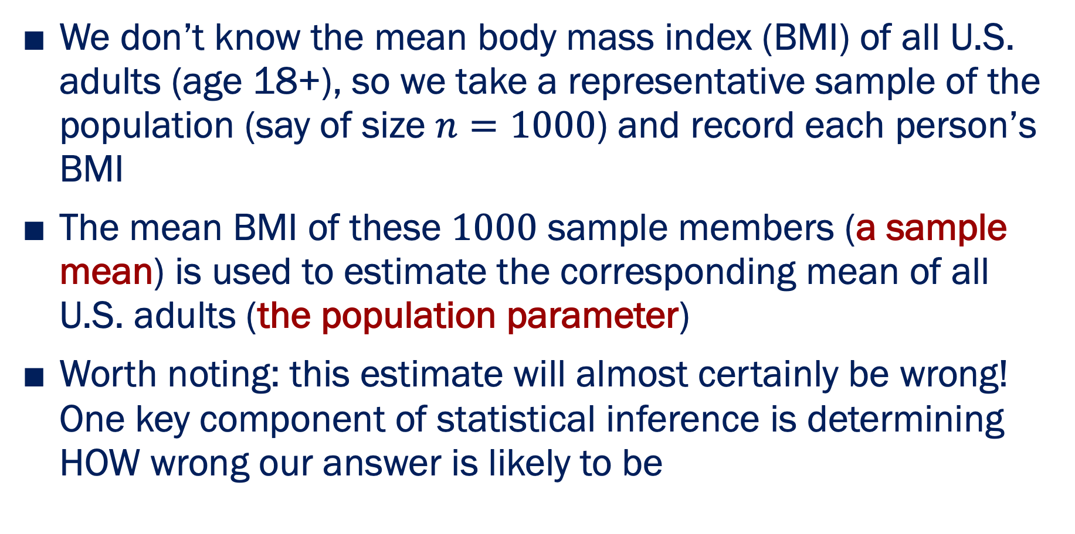
Example
We don’t know the mean body mass index (BMI) of all U.S. adults (age 18+), so we take a representative sample of the population (say of size $n=1000$) and record each person’s BMI
The mean BMI of these $1000$ sample members (a sample mean) is used to estimate the corresponding mean of all U.S. adults (the population parameter)
Worth noting: this estimate will almost certainly be wrong! One key component of statistical inference is determining HOW wrong our answer is likely to be

Slide 16
Types of Variables (1)
Categorical
(qualitative)
Numerical
(quantitative)
Nominal
Ordinal
Continuous
Discrete
Interval
Ratio

Slide 17
Types of Variables (2)
Type | Scale | Description | Example
Categorical | Nominal | No natural ordering | Gender Race
Categorical | Ordinal | Can be ordered/ranked | Stage of disease Severity of Pain
Numerical | Interval (continuous) | Scaled variables; zero is arbitrary | Temperature pH
Numerical | Ratio (continuous) | Zero is point of origin | Age Weight
Numerical | Discrete | Takes on integer values only (count values) | Number of deaths Number of abnormal cells

Slide 18
Types of Variables – Example
ID | Sex | Height_cm | Weight_kg | Heart Rate | Pain
62401 | F | 162.56 | 56.82 | 71 | Mild
62402 | F | 182.88 | 90.91 | 74 | Moderate
62403 | F | 149.86 | 81.92 | 86 | Severe
62404 | M | 139.70 | 47.73 | 86 | Severe
62405 | M | 187.96 | 88.64 | 62 | Mild
62406 | M | 180.34 | 106.82 | 76 | Moderate
Nominal Nominal Continuous Continuous Discrete Ordinal

Slide 19
Types of Statistics
Descriptive Statistics
Summary statistics used to organize and describe the data
Proportions, measures of location (means, median), measures of dispersion (variance, standard deviation), etc.
Inferential Statistics
Statistics used to generalize from the sample
Hypothesis testing, confidence intervals, regression models
t-test, ANOVA, linear regression, etc.

Slide 20
Numerical Variables
More details and R code

Slide 21
Descriptive Statistics: Numerical Variables
Measures of location
Measures of central tendency
Mean
Median
Measures of non-central location
Quartiles
Percentiles
Measures of dispersion
Range
Interquartile Range
Variance
Standard Deviation

Slide 22
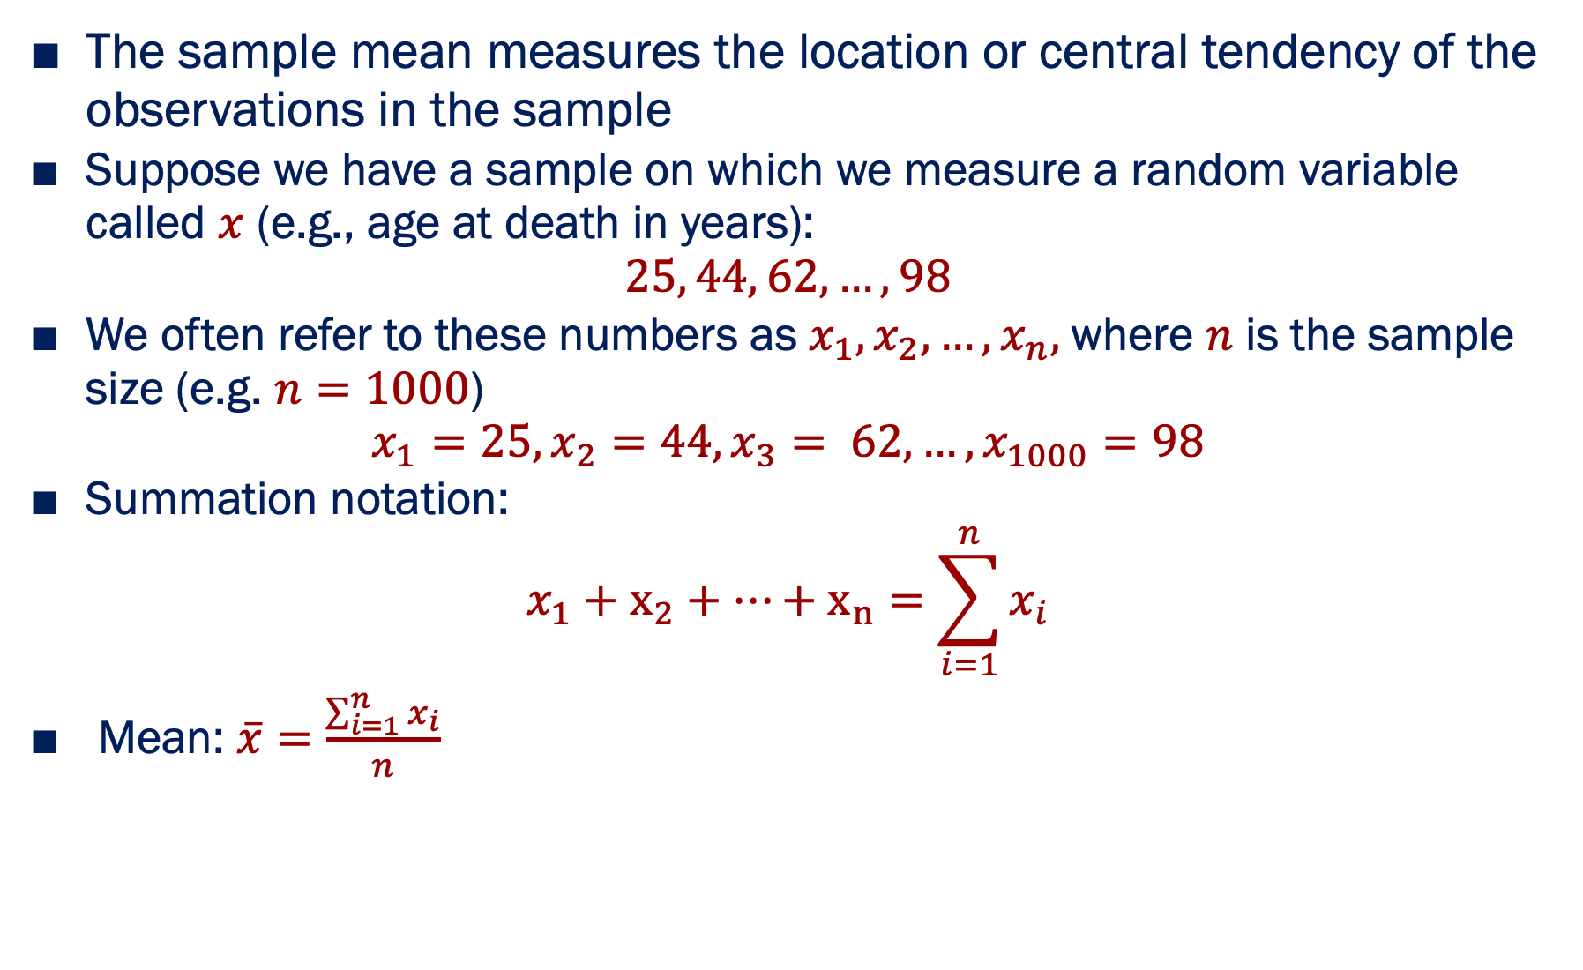
Mean: $\overline{x}$
Measures of location
The sample mean measures the location or central tendency of the observations in the sample
Suppose we have a sample on which we measure a random variable called $x$ (e.g., age at death in years):
$$25, 44, 62, …,98$$
We often refer to these numbers as $x_{1},x_{2},…,x_{n},$where $n$ is the sample size (e.g. $n=1000$)
$$x_{1}=25, x_{2}=44, x_{3}= 62, …,x_{1000}=98$$
Summation notation:
$$x_{1}+x_{2}+…+x_{n}=\sum_{i=1}^{n}{x_{i}}$$
Mean: $\overline{x}=\frac{\sum_{i=1}^{n}{x_{i}}}{n}$

Slide 23
Median
Measures of location
Defined as the 50th percentile (middle value) of a data set
A value such that at least half the data are greater than or equal to it and at least half are less than or equal to it
Median is sometimes more favorable measure of location compared to mean because it is not sensitive to extreme values
E.g., 9 health insurance claims (dollar amounts)
Sorted data: 380, 600, 690, 890, 1050, 1100, 1200, 1900, 890000
Median = 1050, Mean = 99,756.67
Notice the median is unaffected by largest claim number!

Slide 24
Percentiles and Quartiles
Measures of location
The p^{th} percentile of a data set is a number such that at least p% of the data are less than or equal to this value and at least 100 – p% of the data are greater than or equal to this value
Median is 50th percentile (noted earlier)
The 25th, 50th, and 75th percentiles are sometimes called the first, second, and third quartiles of the data
Percentiles give location of center of distribution (median), but also other locations in a distribution

Slide 25
Measures of location in R

Slide 26
Central tendency
•
Commands:
•
•
Calculate means using mean() Calculate medians using median()
> mean( data$BMI ) [1] 25.8492
> median( data$BMI ) [1] 25.8

Slide 27
What if there are missing data?
•
Sometimes there are missing data
•
•
These are represented as NA values
Different functions handle NA values differently

Slide 28
What if there are missing data?
•
Sometimes there are missing data
•
•
These are represented as NA values
Different functions handle NA values differently
•
What is the mean of 3, 4, 5 and NA?
•
•
Pragmatic answer: ignore the missing data, and calculate the average of 3,4 and 5... i.e., mean = 4
Cautious answer: we don’t know the missing value, so we don’t know the mean either... i.e. mean = NA

Slide 29
What if there are missing data?
> age <- c(
> mean( age [1] NA
32, 19, NA, 64 )
)
By default, mean() gives the conservative “don’t know” answer

Slide 30
What if there are missing data?
> age <- c( 32, 19, NA, 64 )
> mean( age ) [1] NA
> mean( age, na.rm=TRUE ) [1] 38.33333
But we can force it to be a pragmatist: tell R to remove the NA values by specifying na.rm=TRUE
(the na.rm argument shows up in quite a lot of functions)

Slide 31
Quartiles and Percentiles
> age <- c( 32, 19, NA, 64 )
We can use the summary function to get the 25th, 50th (median) and 75th percentiles of a variable
> summary(age)
Min. 1st Qu. Median Mean 3rd Qu. Max. NA's
19.00 25.50 32.00 38.33 48.00 64.00 1
Summary will also tell us the minimum, mean, maximum, and if there are any NA’s (and how many)

Slide 32
Quartiles and Percentiles
> age <- c( 32, 19, NA, 64 )
We can use the summary function to get the 25th, 50th (median) and 75th percentiles of a variable
> summary(age)
Min. 1st Qu. Median Mean 3rd Qu. Max. NA's
19.00 25.50 32.00 38.33 48.00 64.00 1
Summary will also tell us the minimum, mean, maximum, and if there are any NA’s (and how many)
> quantile(age,c(.25,.5,.75),na.rm=TRUE)
25% 50% 75%
25.5 32.0 48.0
Can also use function quantile() to specify particular percentile you want.

Slide 33
Quartiles and Percentiles
> age <- c( 32, 19, NA, 64 )
We can use the summary function to get the 25th, 50th (median) and 75th percentiles of a variable
> summary(age)
Min. 1st Qu. Median Mean 3rd Qu. Max. NA's
19.00 25.50 32.00 38.33 48.00 64.00 1
Summary will also tell us the minimum, mean, maximum, and if there are any NA’s (and how many)
> quantile(age,c(.25,.5,.75),na.rm=TRUE)
25% 50% 75%
25.5 32.0 48.0
Can also use function quantile() to specify particular percentile you want.
If we specify .25, .5, and .75 – we get same results as summary

Slide 34
Quartiles and Percentiles
> age <- c( 32, 19, NA, 64 )
We can use the summary function to get the 25th, 50th (median) and 75th percentiles of a variable
> summary(age)
Min. 1st Qu. Median Mean 3rd Qu. Max. NA's
19.00 25.50 32.00 38.33 48.00 64.00 1
Summary will also tell us the minimum, mean, maximum, and if there are any NA’s (and how many)
> quantile(age,c(.25,.5,.75),na.rm=TRUE)
25% 50% 75%
25.5 32.0 48.0
Can also use function quantile() to specify particular percentile you want.
If we specify .25, .5, and .75 – we get same results as summary

Slide 35
Quartiles and Percentiles
> age <- c( 32, 19, NA, 64 )
We can use the summary function to get the 25th, 50th (median) and 75th percentiles of a variable
> summary(age)
Min. 1st Qu. Median Mean 3rd Qu. Max. NA's
19.00 25.50 32.00 38.33 48.00 64.00 1
Summary will also tell us the minimum, mean, maximum, and if there are any NA’s (and how many)
> quantile(age,c(.25,.5,.75),na.rm=TRUE)
25% 50% 75%
25.5 32.0 48.0
Can also use function quantile() to specify particular percentile you want.
If we specify .25, .5, and .75 – we get same results as summary

Slide 36
Try it yourself:
Exercise 2.1.1: Central Tendency
Compute the mean of Age, the age of the subjects in the data set
Compute the median of Age
Apply the summary() function to the variable Age
Obtain the 33rd, 50th, and 87th quantiles of the variable Age using quantile()

Slide 37
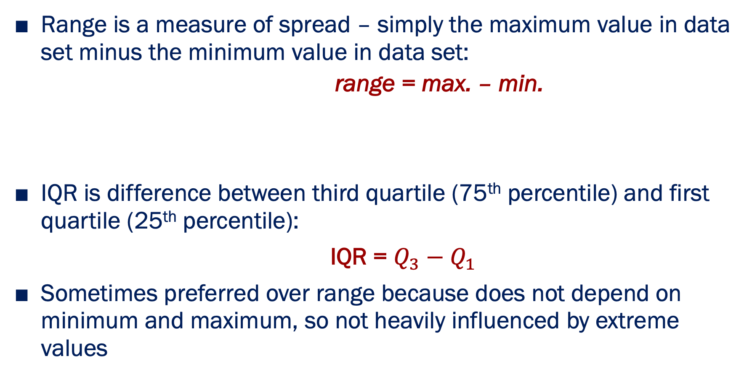
Range
Measures of dispersion
Range is a measure of spread – simply the maximum value in data set minus the minimum value in data set:
range = max. – min.
IQR is difference between third quartile (75th percentile) and first quartile (25th percentile):
IQR = $Q_{3}−Q_{1}$
Sometimes preferred over range because does not depend on minimum and maximum, so not heavily influenced by extreme values
Interquartile Range (IQR)

Slide 38
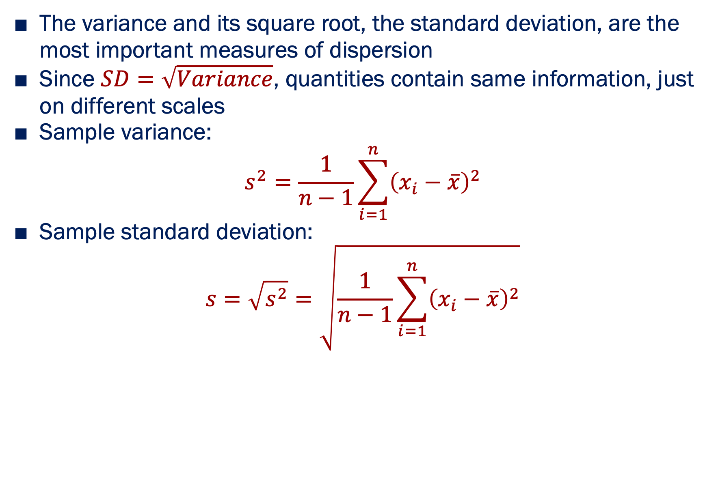
Variance and Standard Deviation (SD)
Measures of dispersion
The variance and its square root, the standard deviation, are the most important measures of dispersion
Since $SD=\sqrt{Variance}$, quantities contain same information, just on different scales
Sample variance:
$$s^{2}=\frac{1}{n−1}\sum_{i=1}^{n}{{\left(x_{i}−\overline{x}\right)}^{2}}$$
Sample standard deviation:
$$s=\sqrt{s^{2}}=\sqrt{\frac{1}{n−1}\sum_{i=1}^{n}{{\left(x_{i}−\overline{x}\right)}^{2}}}$$

Slide 39
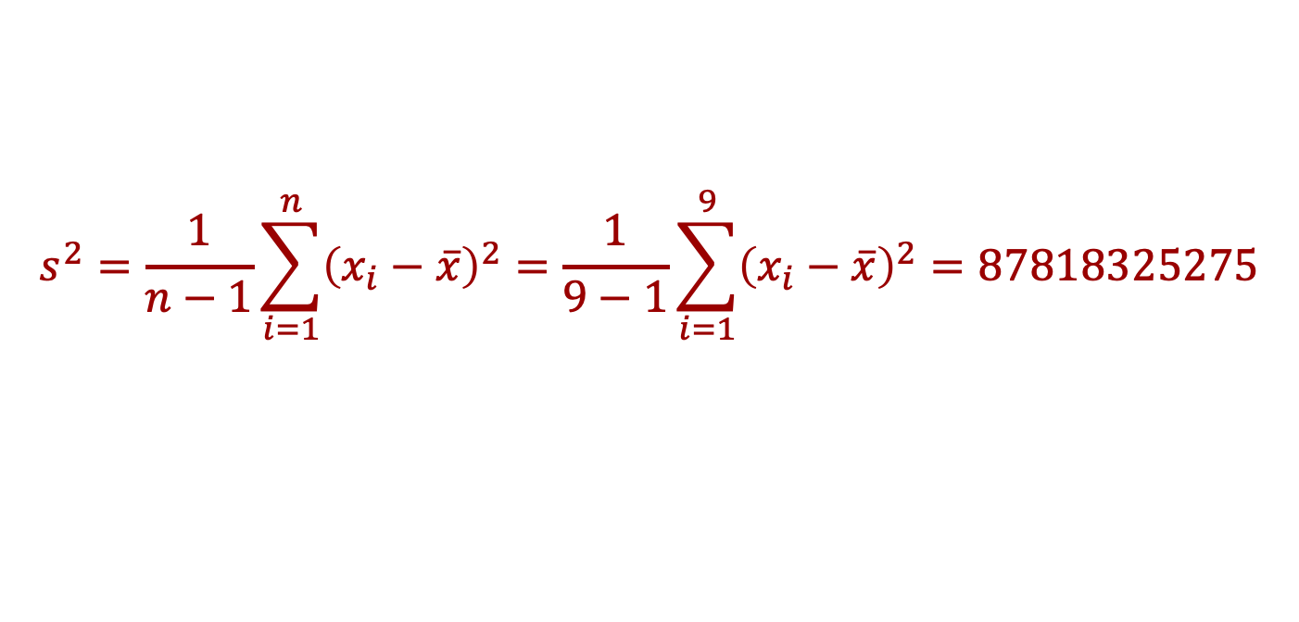
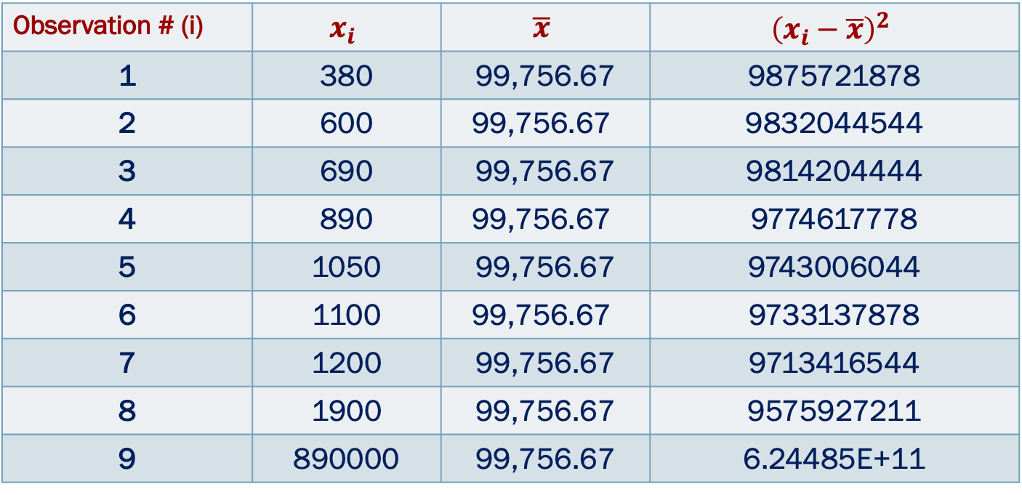
Variance and Standard Deviation (SD) Example: Consider this insurance claim data
Measures of dispersion
Observation # (i) | $$x_{i}$$ | $$\overline{x}$$ | $${\left(x_{i}−\overline{x}\right)}^{2}$$
1 | 380 | 99,756.67 | 9875721878
2 | 600 | $$\text{99,756.67}$$ | 9832044544
3 | 690 | 99,756.67 | 9814204444
4 | 890 | $$\text{99,756.67}$$ | 9774617778
5 | 1050 | 99,756.67 | 9743006044
6 | 1100 | $$\text{99,756.67}$$ | 9733137878
7 | 1200 | 99,756.67 | 9713416544
8 | 1900 | 99,756.67 | 9575927211
9 | 890000 | 99,756.67 | 6.24485E+11
$$s^{2}=\frac{1}{n−1}\sum_{i=1}^{n}{{\left(x_{i}−\overline{x}\right)}^{2}}=\frac{1}{9−1}\sum_{i=1}^{9}{{\left(x_{i}−\overline{x}\right)}^{2}}=87818325275$$

Slide 40
Spread in R
•
•
•
•
Range: range() Interquartile range: IQR() Standard deviation: sd()
Variance: var()
> range(data$BMI) [1] 14.3 37.7
> IQR(data$BMI) [1] 5.3
> sd(data$BMI) [1] 3.944868
> var(data$BMI) [1] 15.56198

Slide 41
Try it yourself:
Exercise 2.1.2: Spread
Compute the standard deviation of mpg
Compute the mpg range in this data
Compute the interquartile range on the mpg
Compute the 10th, 25th, 75th and 90th percentiles for mpg

Slide 42
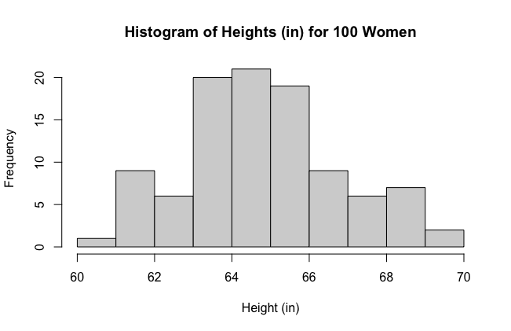

Graphical Methods for Numerical Variables
Histogram: indicates the distribution of the values of a numerical variable
Example: Consider the height (in inches) of 1000 women
$\overline{x}=64.82, median=64.45, s=1.99$

Slide 43
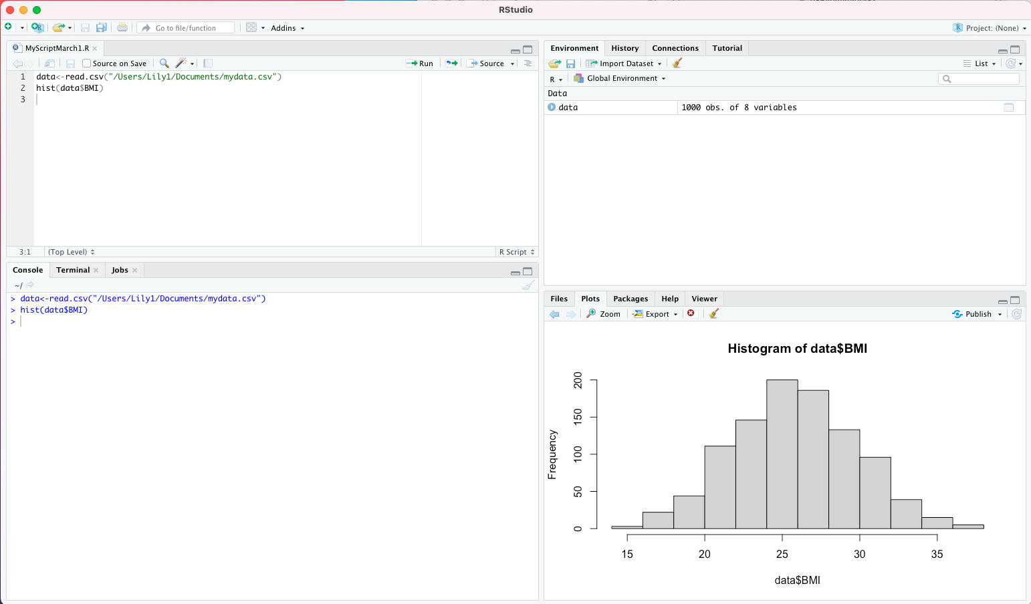
Plots in R

Slide 44
Plots in R
If you run a command for a plot, the plot is going to appear in the bottom right panel!

Slide 45
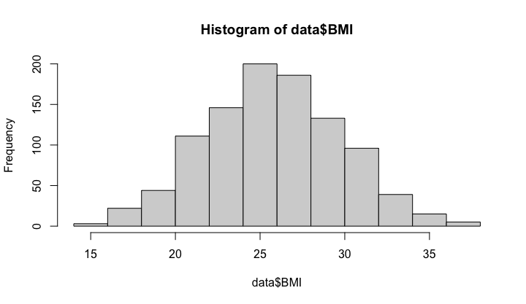
Histogram in R
> hist(data$BMI)
We can change the y axis, x axis, and title if we want!

Slide 46
Histogram in R
>hist(data$BMI,
xlab="BMI",
ylab="Frequency",
main="My Histogram of BMI")
xlab changes x axis,
ylab changes y axis,
main changes plot title

Slide 47
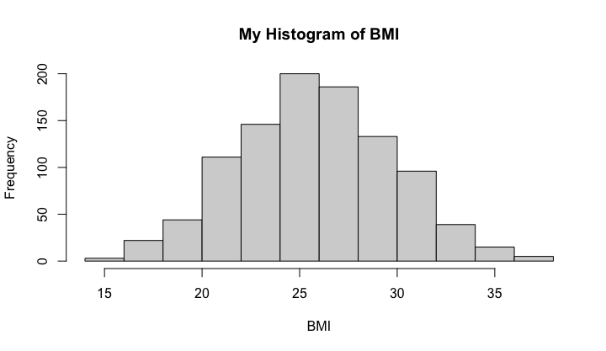
Histogram in R
>hist(data$BMI,xlab="BMI",ylab="Frequency",main="My Histogram of BMI")
xlab changes x axis,
ylab changes y axis,
main changes plot title

Slide 48
Other ways to plot numerical data in R
> plot(data$BMI)
plot() will plot the raw data as points, with each person on the x axis and the variable on the y axis

Slide 49
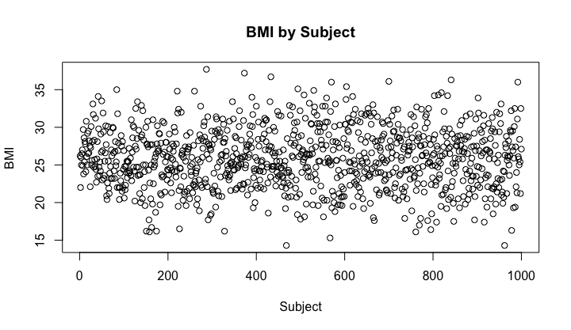
Other ways to plot numerical data in R
> plot(data$BMI)
plot() will plot the raw data as points, with each person on the x axis and the variable on the y axis
> plot(data$BMI, xlab=”Subject",ylab=”BMI",main="BMI by Subject")
Can change the x axis, y axis, and title the same as before!

Slide 50
Try it yourself:
Exercise 2.1.3: Plotting Numerical Variables
Use the hist() function to create a histogram of the variable Age. Practice changing the x axis, y axis, and title!

Slide 51
Categorical Variables
More details and R code

Slide 52

Descriptive Statistics: Categorical Variables
Frequency ($f$): Number (#) of subjects in each category
Relative frequency ($\frac{f}{n}×100$): Proportion of subjects in each category
Example: Distribution of 50 patients according to their ABO blood groups
Blood group | Frequency | %
A B AB O | 12 18 5 15 | 24.00 36.00 10.00 30.00
Total | 50 | 100.00

Slide 53
Descriptive Statistics: Two Categorical Variables
For two categorical variables, consider a contingency table or cross-tabulation
Example: contingency table giving the joint frequency distribution of blood group and sex (male or female) for 50 patients:
Notice the margins give the univariate frequency distributions of the two variables
 |  | Sex
 |  | Female | Male | Total
Blood group | A | 7 | 5 | 12
 | B | 10 | 8 | 18
 | AB | 2 | 3 | 5
 | O | 8 | 7 | 15
 | Total | 27 | 23 | 50

Slide 54
Tabulating and cross-tabulating categorical variables in R

Slide 55
Tabulating using table()
> table( data$gender )
Frequency table for gender
Female Male
531 469

Slide 56
Proportions instead of frequencies using prop.table()
> table( data$gender )
Frequency table for gender
Female Male
531 469
> prop.table(table(data$gender))
Proportion table for gender
Female Male
0.531 0.469

Slide 57
Tabulating two variables using table()
> table(data$Gender,data$HighCholesterol)
We can get a cross tabulation simply by listing more variables in the input
0 1
Female 405 126
Male 366 103
Note: for some categorical variables, we have 1s and 0s as the data instead
So for this “High Cholesterol” variable, 1 means YES or TRUE , 0 = NO or FALSE

Slide 58
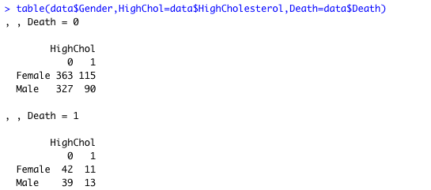
Adding a third variable gives a three way cross-tabulation

Slide 59

Note: might want to add labels to tables to specify what you are looking at, especially if you are considering two variables with 0/1 values
We can do this by adding a name (any name), followed by the = that is specifying the variable
Adding a third variable gives a three way cross-tabulation

Slide 60
Try it yourself:
Exercise 2.1.4: Tabulation
Use table() to construct a tabulation of the Hypertension variable (0 = no hypertension, 1=hypertension)
Using this table, create a table of proportions using prop.table()
Now use table() to cross-tabulate Hypertension by Gender

Slide 61
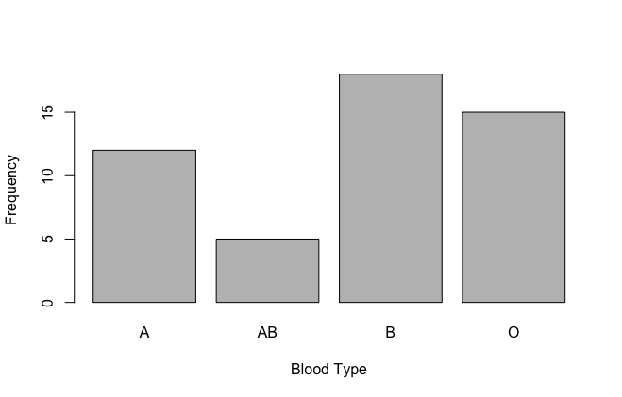
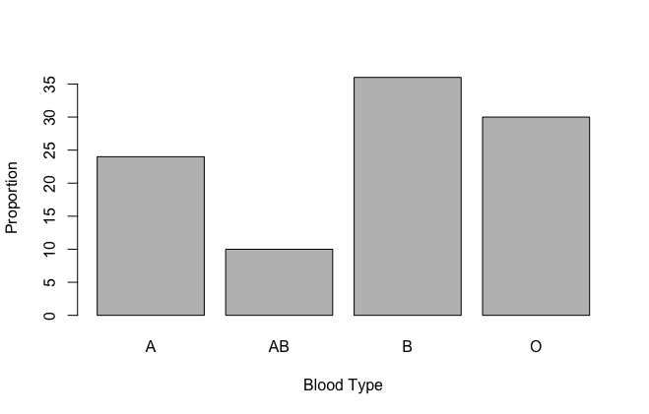
Graphical Methods for Categorical Variables
Bar plots: indicate frequency or relative frequency distribution
Example: 50 patients with ABO blood groups

Slide 62
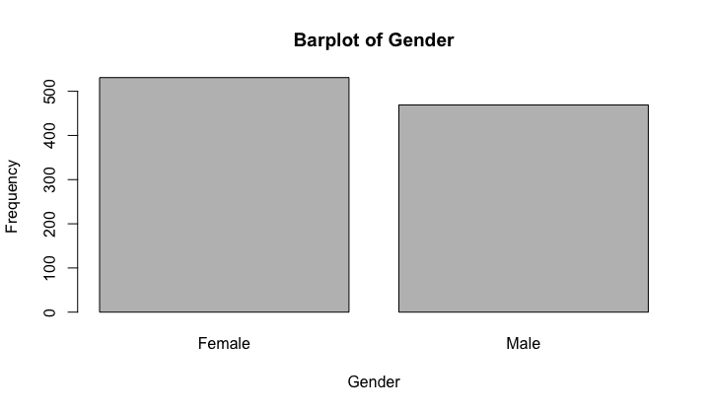

Bar plots in R
Apply barplot() function to table() and prop.table() function to plot frequencies and proportions, respectively
> barplot(table(data$gender))
> barplot(prop.table(table(data$gender)))

Slide 63
Try it yourself:
Exercise 2.1.5: Plotting Categorical Variables
Save the table of frequencies and proportions and plot them separately using barplot()

Slide 64
Correlating two variables

Slide 65
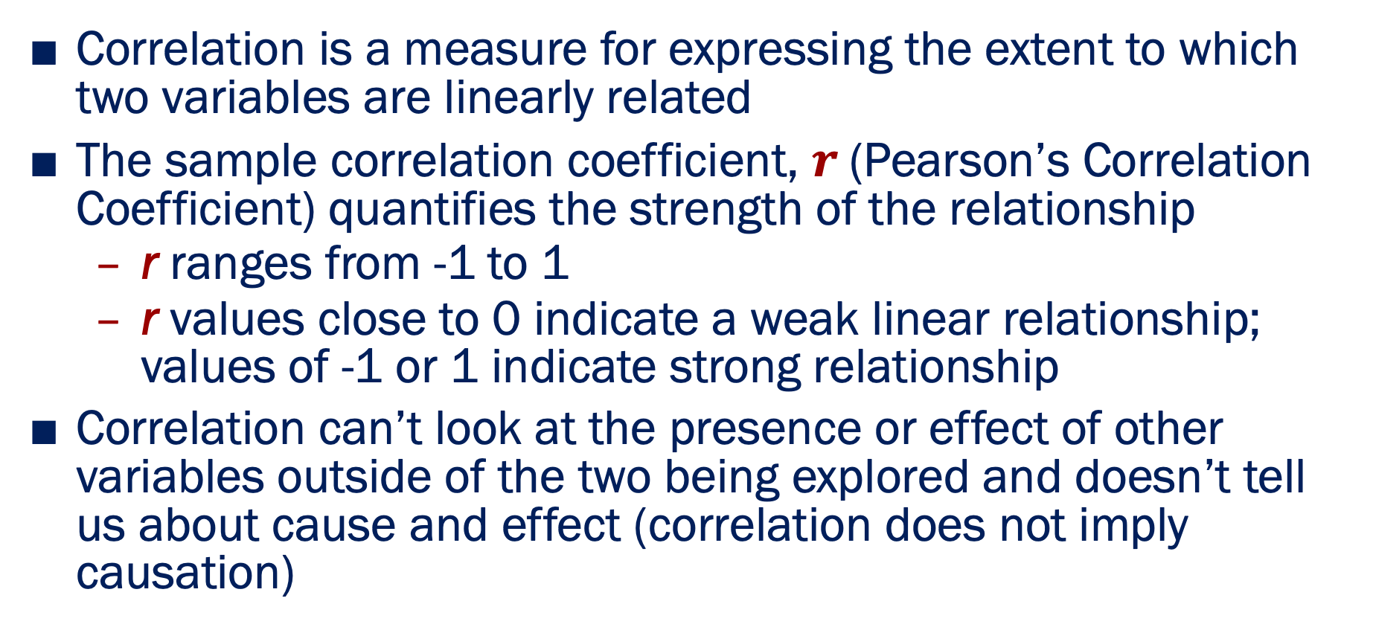
Correlations
Correlation is a measure for expressing the extent to which two variables are linearly related
The sample correlation coefficient, $r$(Pearson’s Correlation Coefficient) quantifies the strength of the relationship
r ranges from -1 to 1
r values close to 0 indicate a weak linear relationship; values of -1 or 1 indicate strong relationship
Correlation can’t look at the presence or effect of other variables outside of the two being explored and doesn’t tell us about cause and effect (correlation does not imply causation)

Slide 66
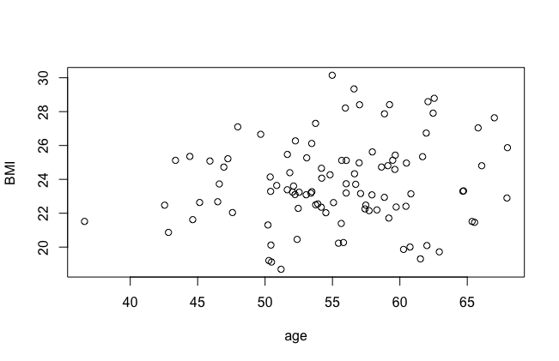

Correlations
Example: examine correlation between age and BMI in a group of 100 adults
$r=0.158$
Use Scatterplot:

Slide 67
Correlations in R
> cor( data$Age, data$BMI )
[1] 0.01151343

Slide 68
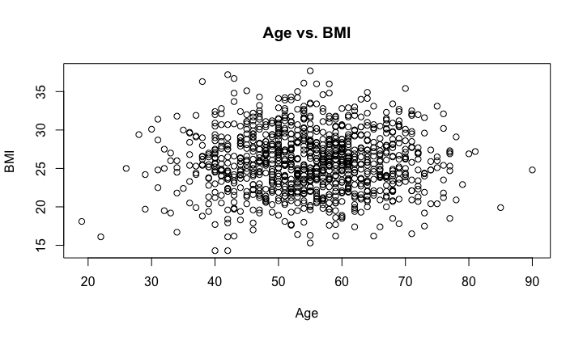
Using scatterplots to understand the relationship between two variables in R
> plot(data$Age,data$BMI,xlab="Age",ylab="BMI",main="Age vs. BMI")
There does not appear to be any obvious linear relationship here!

Slide 69
Try it yourself:
Exercise 2.1.6: Plotting Categorical Variables
Calculate the correlation between the BMI and Systolic Blood Pressure of each subject using cor()
Use plot() to plot BMI vs. Systolic Blood Pressure to further assess for a linear relationship between these variables.

Slide 70

In Summary:
Suppose we have a vector of data, e.g.
$$Age=(68, 65, 64, …,70, 58)$$
Statistic | Function in R
Sum | sum(x)
Mean | mean(x)
Median | median(x)
Largest Value | max(x)
Smallest Value | min(x)
Standard Deviation | sd(x)
Variance | var(x)
Number of elements | length(x)
Correlation between x and y | cor(x,y)

Slide 71
Important Practical Matters in R:
The environment and packages

Slide 72
The environment

Slide 73
The environment
•
The R “environment” consists of all of the variables that you have loaded or defined
•
•
•
e.g. age, BMI, etc
These are all variables in the workspace
R holds them in memory; you can save them to disk if you want to (see later)

Slide 74
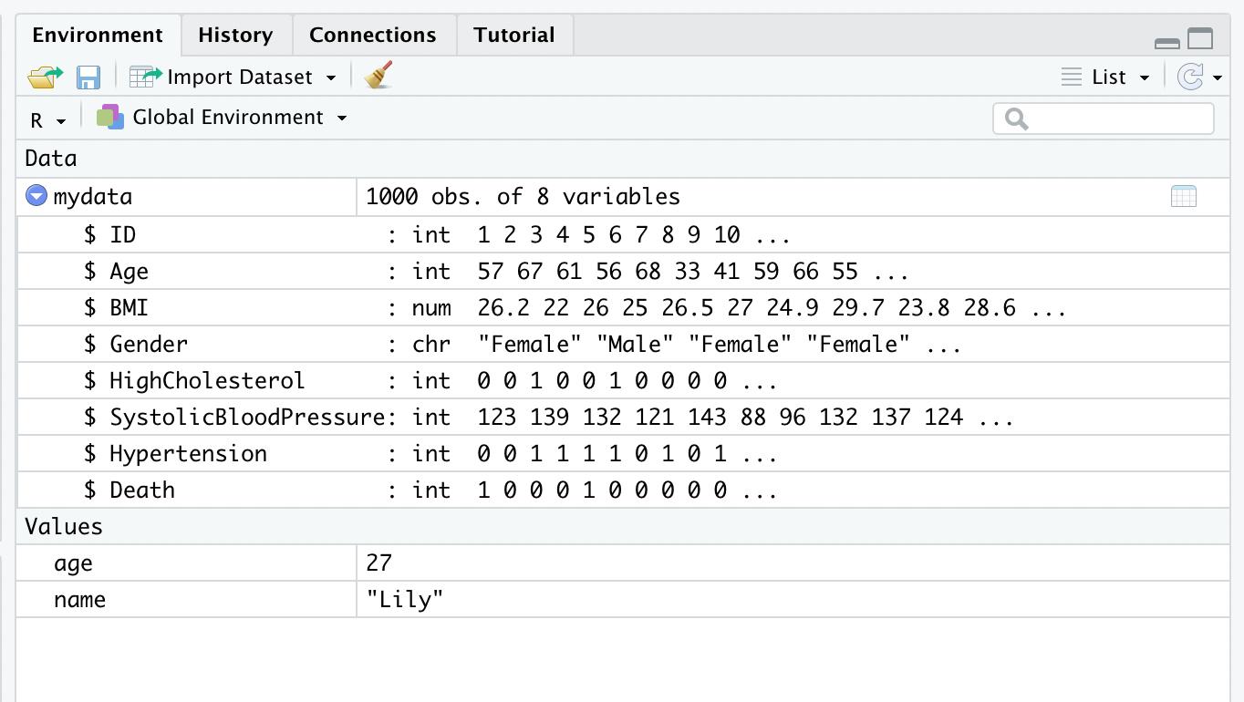
Rstudio gives some summary information about the environment

Slide 75
Rstudio gives some summary information about the environment
Shows we have data frame mydata with 1000 observations (people) and 8 variables

Slide 76
Rstudio gives some summary information about the environment
Shows that BMI inside the data frame mydata numeric

Slide 77
(R commands to do the same thing)
> class(mydata$BMI) [1] "numeric"

Slide 78
Delete everything from the environment?
Click here (you will be asked to confirm before deletion occurs)

Slide 79
Deleting just one variable using NULL
before...
NULL is a special “value” in R that means “this variable does not exist” or “it has no value”. It is different to NA, which means “the variable exists (and in principle has a value), but that value is missing/unknown”
> mydata$BMI<-NULL

Slide 80
Deleting just one variable using NULL
before...
NULL is a special “value” in R that means “this variable does not exist” or “it has no value”. It is different to NA, which means “the variable exists (and in principle has a value), but that value is missing/unknown”
> mydata$BMI<-NULL

Slide 81
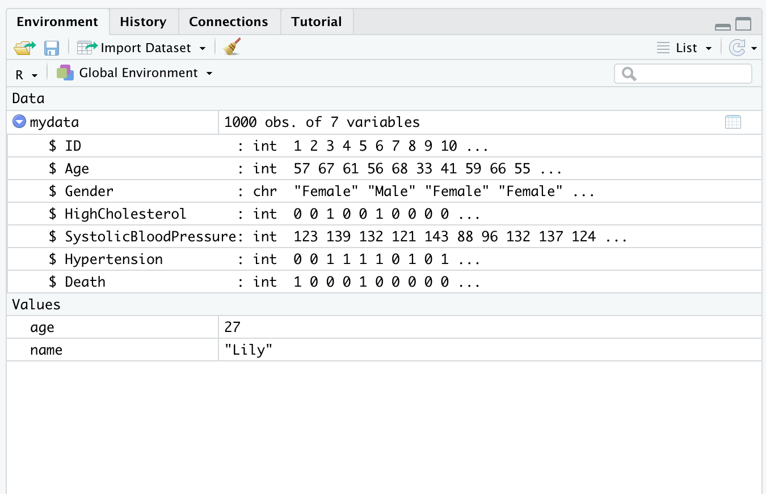
Deleting just one variable using NULL
after...

Slide 82
We might have variables in the environment, but not in a data frame

Slide 83
We might have variables in the environment, but not in a data frame
before...
Can remove a single variable from the environment (if not in data frame) using rm() function
> rm(age)

Slide 84
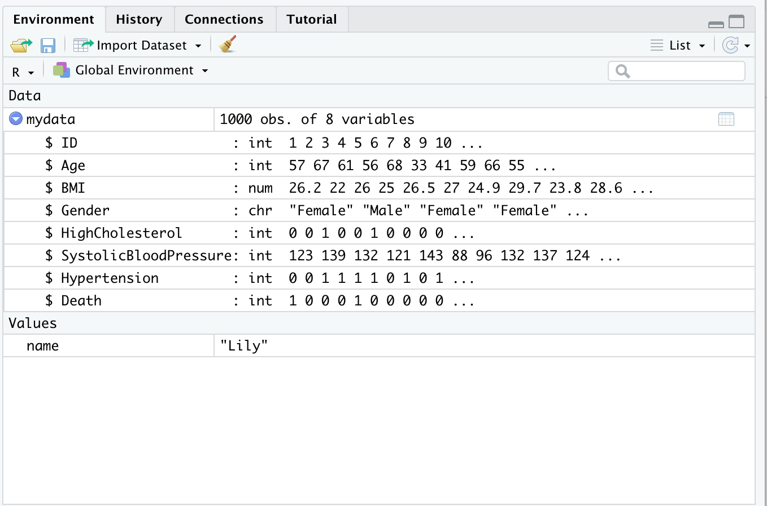
Delete a single variable using rm() function
after…

Slide 85
Try it yourself:
Exercise 2.2.1: Understanding the environment and removing variables
Clear the environment using RStudio's “clear objects from the environment” button
Delete the variable Death from mydata using the <- NULL approach
Try to print out the variable you just removed (mydata$Death) to see what happens!
Create a character variable called color (not inside mydata, just in R environment) that represents your favorite color and then remove it using rm()

Slide 86
Installing and loading packages

Slide 87
Packages
•
What is a package?
•
•
•
•
A collection of R functions and data sets that someone has contributed to the R “ecosystem”
Packages extend the functionality of R: most of the value to R comes from the 5000+ packages out there
If you can’t find a function in “base” R, it might be available in a package
People often write their own packages for easy access to functions, new statistical methods, etc.

Slide 88
Installing packages
Example: ggplot2
An excellent R package for even better data visualization
#Install package
install.packages("ggplot2")
#Then, subsequently load that package
library(“ggplot2”)

Slide 89
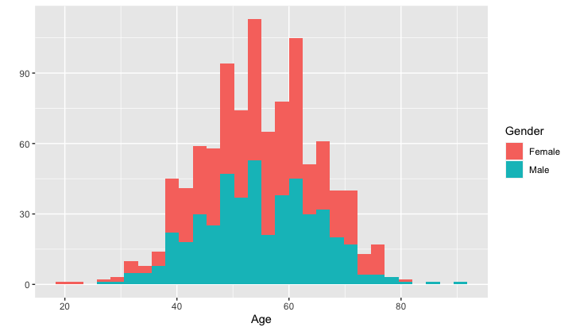
Example of what ggplot2 can do
Make an even fancier histogram!
# Basic histogram
qplot(weight, data = mydata, geom = "histogram")
# Change histogram fill color by group (gender)
qplot(weight, data = mydata, geom = "histogram", fill = Gender)

Slide 90
Try it yourself:
Exercise 2.2.2: Installing Packages
Install ggplot2 using install.packages()
Load ggplot2 using library()

Slide 91
Thank You!
Questions?

Slide 92
References
Introduction to Biostatistics, Larry Winner, Department of Statistics University of Florida
Introduction to Biostatistics, Jonggyu Baek, University of Massachusetts Medical School
Introduction to Biostatistics, University of Georgia
Introduction to Biostatistics for Clinical and Translational Researchers, KUMC Departments of Biostatistics & Internal Medicine, University of Kansas Cancer Center
Introduction to R, Dan Navarro (daniel.navarro@adelaide.edu.au) School of Psychology, University of Adelaide, ua.edu.au/ccs/people/dan CSIRO R Workshop, 28-Nov-2013
Introduction to Biostatistics & R 2022, Lillian Boe, University of Pennsylvania

